Slide 1
VIA Tool Instruction

Slide 2
Tutorial
Official Website
Get Started : A basic user guide is also available inside the VIA application and can be accessed using top menubar "Help -> Getting Started".
Video Instruction (In video, it used version 2.02. Its keyboard shortcuts are little different with version 2.11(now using) )

Slide 3
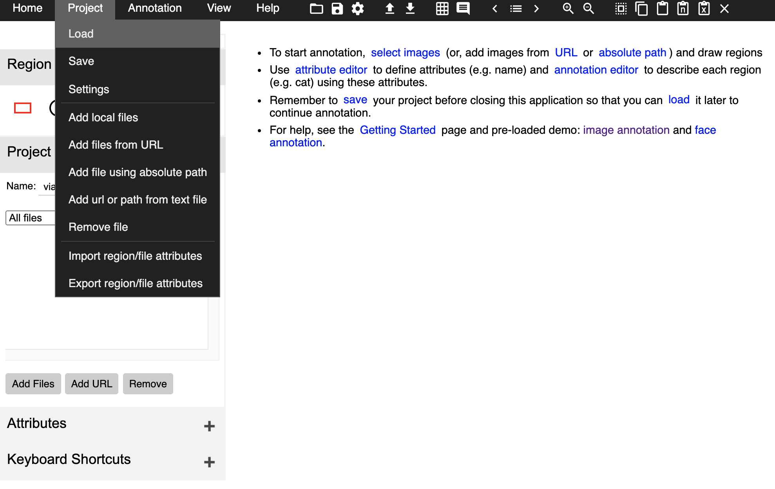
Steps of annotation on building type
Download the github repo , there are two dataset folder. ‘train’ and ‘val’ need to be annotated
Open the vai/via.html
Click Project => Load => Select train.json/ val.json

Slide 4
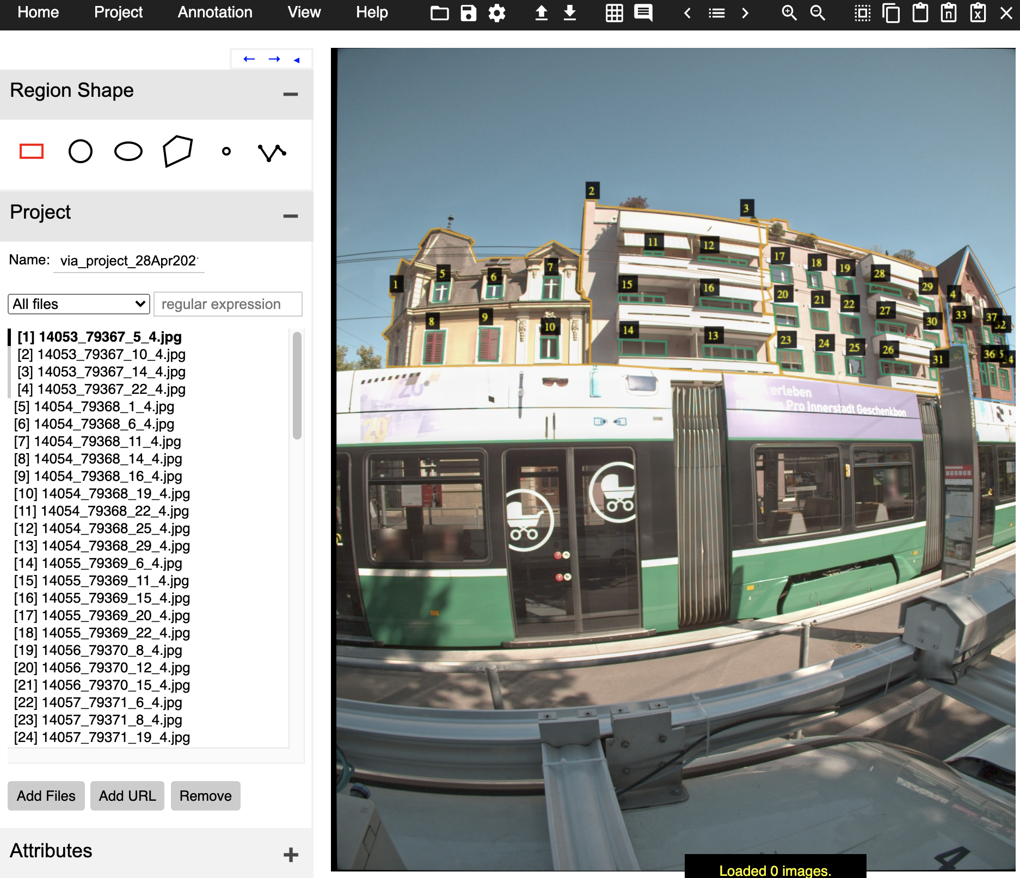
Steps
3. Click add file, select all the image in the train folder, and your screen will be like:

Slide 5
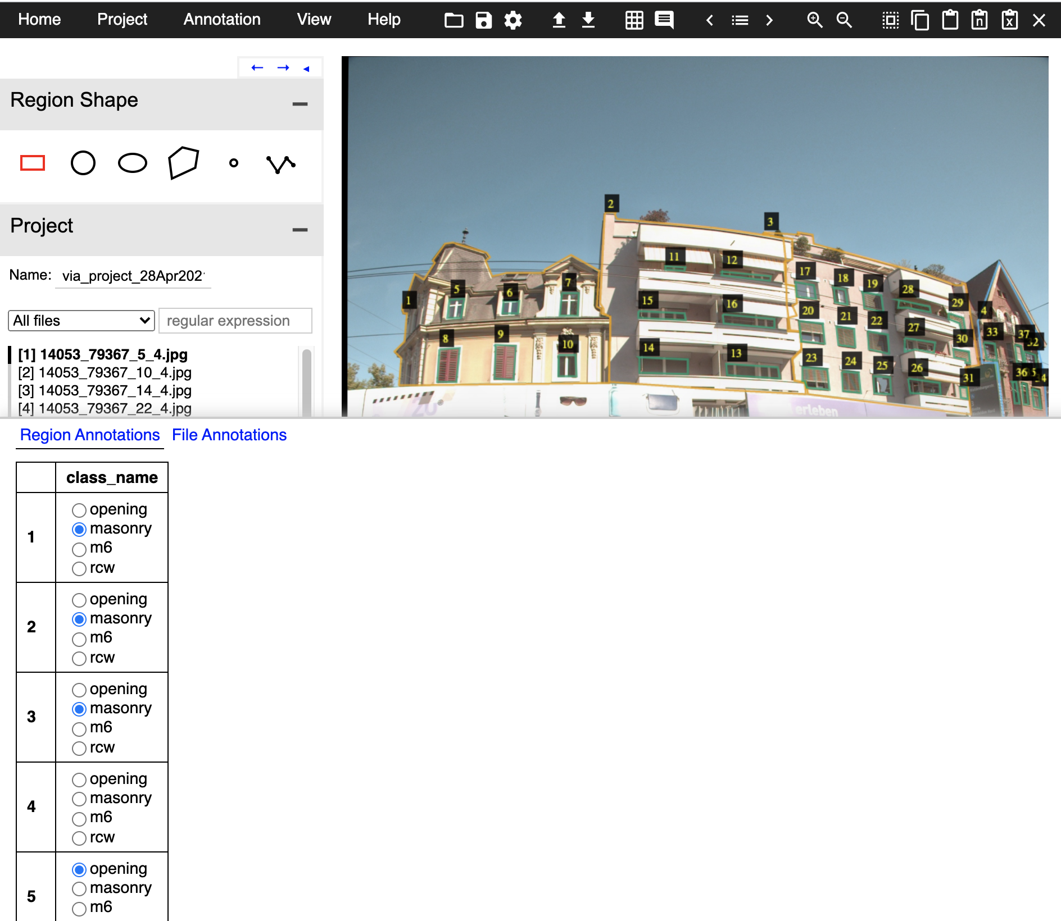
Steps
4. For each images, Click spacebar and you can choose the building type.
There are 4 classes, opening, masonry, m6, rcw. Default is masonry.
Usually, label number of buildings is in the beginning,
Here it is 1, 2, 3

Slide 6

Steps
5.
Usually, label number of buildings is in the beginning,
Here it is 1, 2, 3
Different color shows different class ( press to show the class color)

Slide 7
Steps
6.
After annotating all the images, click Project => Save. And you can get a .json file.
All finish!

Slide 8
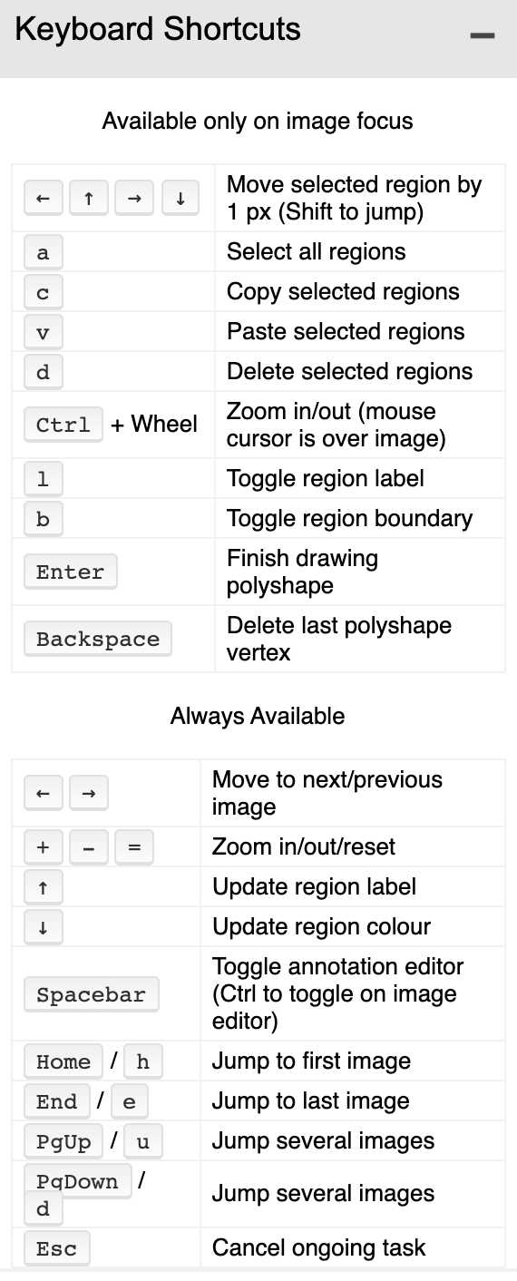
Keyboard shortcut
Here
Esc, spacebar are used frequently

Slide 9
Note
If you find some mislabel building, please record its file name
If you encounter any problem, please contact me( yaxiong.luo@epfl.com ). Thanks

